Slide 1


NPM
Node Package Manager
Gagandeep Singh

Slide 2
Why npm?
npm is the world's largest software registry.
The registry contains over 800,000 code packages.
Open-source developers use npm to share software.
Many organizations also use npm to manage private development.
npm is free to use.
You can download all npm public software packages without any registration or logon.
npm is installed with Node.js

Slide 3
npm uses:
Adapt packages of code for your apps, or incorporate packages as they are.
Run packages without downloading using npx.
Share code with any npm user, anywhere.
Restrict code to specific developers.
Manage multiple versions of code and code dependencies.
Discover multiple ways to solve the same puzzle.
Find other developers who are working on similar problems and projects.

Slide 4
gcss_lib
I created a styles.css file where I have built a basic CSS code which can be used just like bootstrap on a HTML file.
It’s my personalized library where I just have to mention class name in HTML tags to access those styles in my web page.
Here’s the link of my Github repo: “https://github.com/gagancod3/gcss_lib”

Slide 5
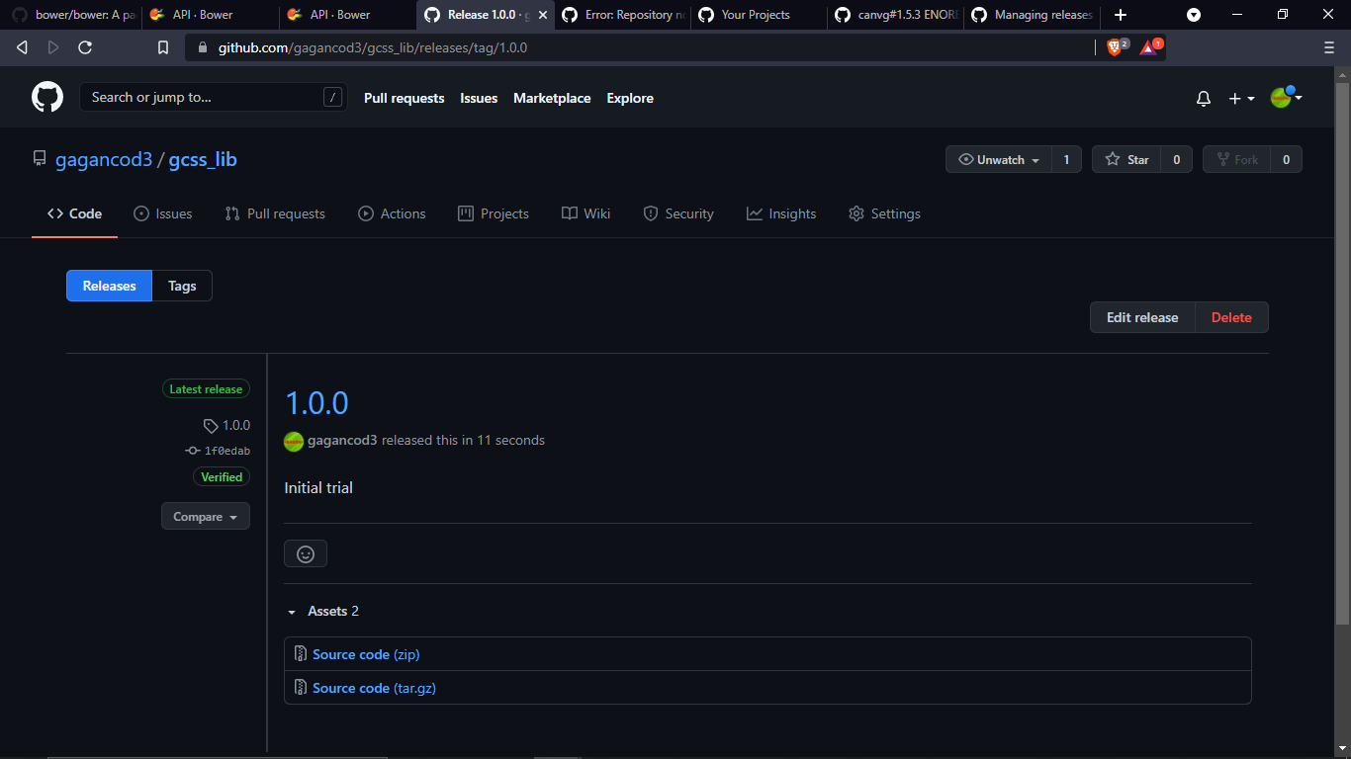
Created version of Github repo

Slide 6
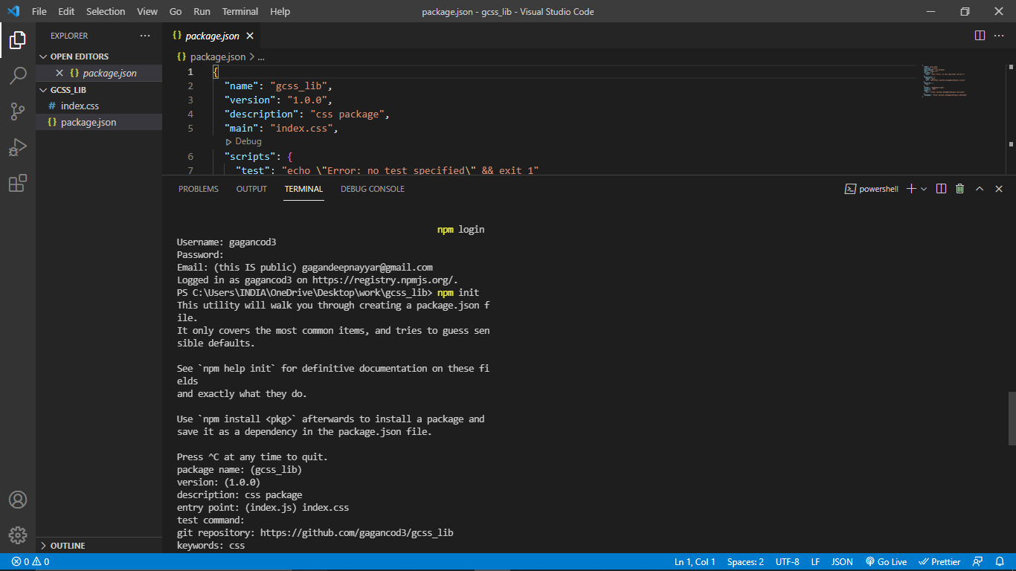
Creating package.json file

Slide 7
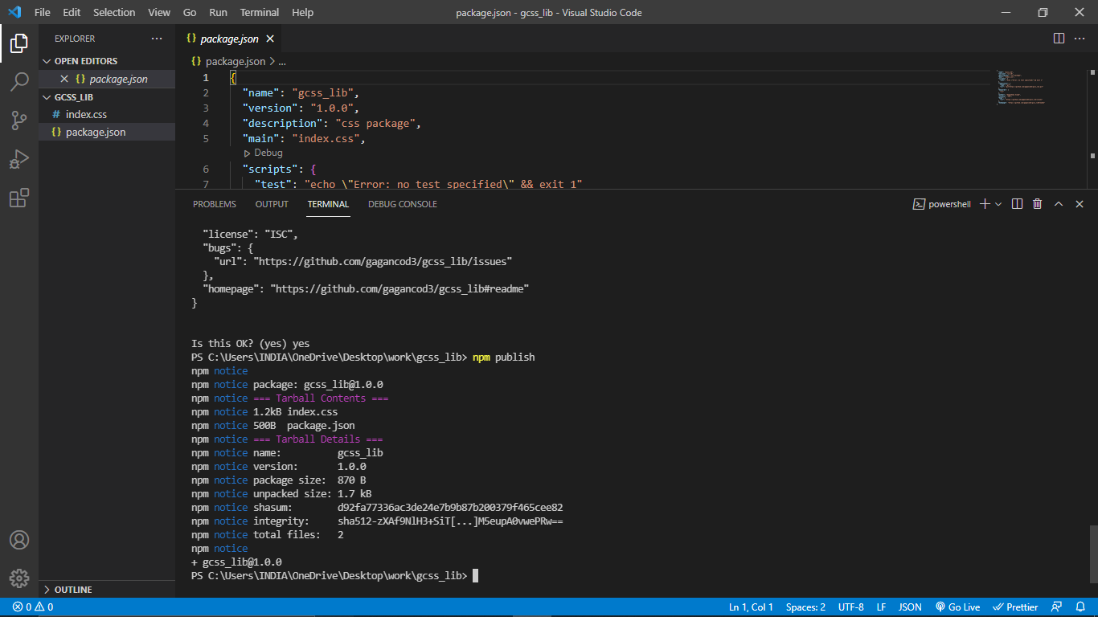
Successfully published to npm

Slide 8
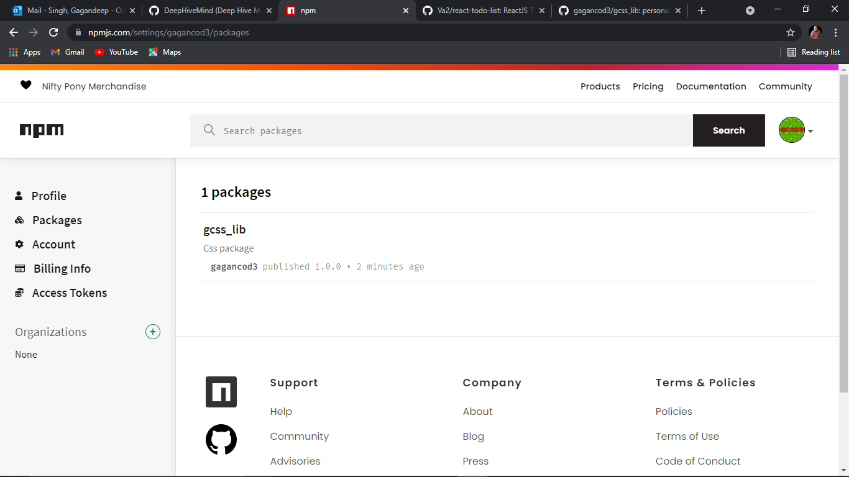
Uploaded on my npm packages

Slide 9
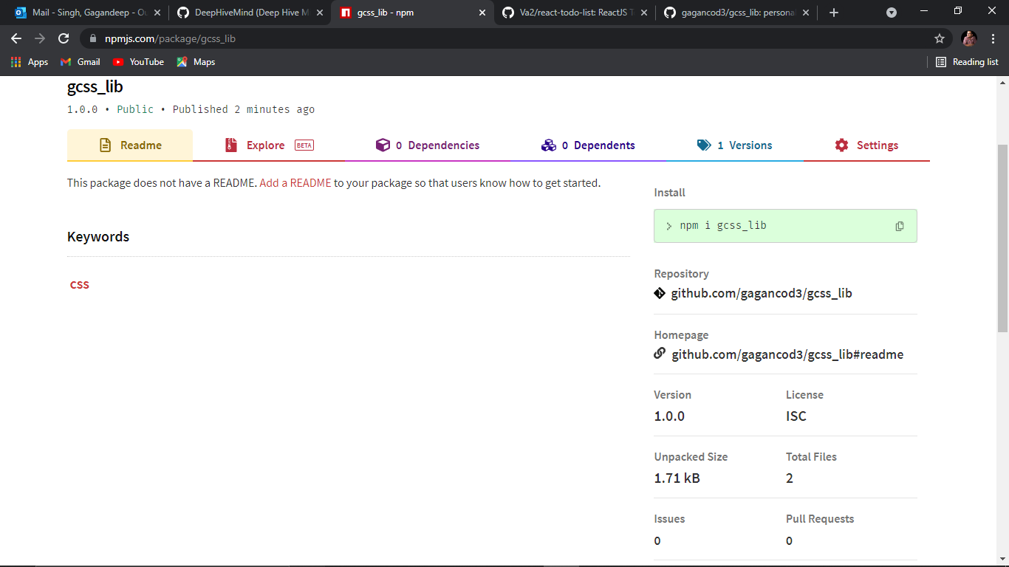
Install package using: ‘npm i gcss_lib’

Slide 10
Thankyou

